Slide 1

Analyzing E-Commerce Shipment Delivery and Customer Satisfaction
G. Chandrashekar
V. Vineela
Deepika
T. Bunny
Under the guidance of
Maram Ramadevi
Assistant Professor

Slide 2
Index:
Abstract
Introduction
Motivation
Problem Definition
Literature Survey
Research Gaps
Proposed System
Existing Methodology
Drawbacks
Proposed Methodology
Software Details
Detailed proposed methodology
Sample code
Packages used
Result analysis
Advantages & applications
Conclusion
Feature scope
References

Slide 3
Abstract
Our project is developed to analyze the relationship between e-commerce shipment delivery and customer satisfaction. It focuses on studying shipment data to understand delivery trends, identify delay patterns, and evaluate their impact on customer reviews and satisfaction. The platform allows users to explore key features such as delivery time, tracking accuracy, communication effectiveness, and product quality through user input, data visualization.The system also provides recommendations to improve delivery efficiency, enhance user experience, and reduce return rates. It serves as a practical tool for understanding and improving the online shopping delivery process.

Slide 4
Introduction
In last few years E-commerces services growing continuously especially after the COVID-19 pandemic the e-commerces activitys has been growing rapidly
To keep up the competition we have to continuously improving quality of service,efficient &reliable shipment delivery for customer satisfaction
By addressing problems such as delayed shipments,insufficient routing etc… to solve such problems leveraing technology like location intelligence enables faster delivery times.
Also providing a greater transparency ,enhanced flexibility and make customer satisfied

Slide 5
Motivation
The main motivation developing E-commerce shipment delivery and customer satisfaction is to enhance customer experience
And understand how the shipment and delivery process influences customer satisfication. As online shopping becomes more common customer expectations on delivery such as speed,accuracy,and communication
This application aims to explore these expectations and identify the gaps in current delivery,suggests strategies.
that how online stores can improve their services to make customer more satisfied and build long term loyallity

Slide 6
Problem Definition
In the competitive landscape of e-commerce, customer satisfaction plays a vital role in the success and sustainability of online retailers. One of the most critical factors influencing customer satisfaction is the effectiveness of shipment delivery, which includes timely delivery, order accuracy, and condition upon arrival. Delays or issues in the delivery process often lead to negative customer experiences, affecting brand reputation and customer retention.

Slide 7
Literature Survey
Author | Year | Existing system | Proposed system | Key takeaways
Gupta.R ,Sharma.T, & Mehta S | 2023 | Manual logistics operations with limited AI use; traditional routing algorithms | AI-driven logistics optimization using ML for predictive demand & route planning | AI significantly enhances delivery scheduling, inventory management, and routing
Aniket Pratap Singh, Pritam Das | 2022 | Rule-based and keyword-driven sentiment analysis | Deep learning and NLP-based sentiment mining from user reviews | Improved accuracy in detecting customer sentiment from reviews
Liang Chen, Yuan Zhang, Hao Wu | 2021 | Post-delivery risk reporting using static historical data | Real-time AI-based risk assessment using live logistics data | Enables dynamic rerouting and reduces delivery delays using real-time data

Slide 8
Research Gaps
Many systems use simple techniques to find unhappy customers. They don’t use powerful AI tools like deep learning, which can understand customer reviews and patterns better
Most companies only take action after a customer complains. There is a need for smart systems that can guess when a customer might be unhappy and fix the issue before it becomes a problem
Many customers write reviews in their local languages. Most systems only read English reviews, so they miss out on important feedback from other users

Slide 9
Proposed System
The platform that designed to help customer by collecting and analyse data related to shipment delivery and customer satisfaction
Tracks delivery times, compares them with expected dates, and highlights frequent problems
Provides suggestions to improve delivery services and enhance customer satisfaction based on real data
Allows customers to rate delivery experiences and report issues like delays or damaged products.

Slide 10
Existing Methodology
The current approach focus on collecting data from shipment, delivery records and customer feedback after delivery. It mainly uses basic methods to look at things like how the packages arrive on time and how long delivery takes average .
Customer satisfaction is measured through surveys , giving some feedbacks into there experience.while this is work for tracking past performance , it does not provide real time updates or help to predict the issue before that happen
Which may cause mis the chance to improve delivery efficiency and customer service

Slide 11
Drawbacks
The current system gives a normal idea of how deliveries are going but it comes with some limitations. Since it mainly relies on past data also it struggles to predict or prevent future delays. Key factors like traffic, weather, or sudden changes in orders are not included which reduces its accuracy
Customer feedback is mostly gathered through surveys but those are have low response rates and Without real-time tracking or smarter analytics, issues can go unnoticed until customers are already unhappy

Slide 12
Proposed Methodology
To improve delivery performance, the new approach focuses on using smart technology and real-time data. Machine learning helps predict possible delays by analyzing trends and external factors like traffic or weather. Shipments are tracked live using GPS and constant or direction given by customer
Instead of waiting for survey responses customer feedback is quickly reviewed using sentiment analysis. All the information is gathered together in a live dashboard that highlights issues as that happen.
The goal is to fix problems before they grow and give customers a smoother more reliable experience.

Slide 13
Software Details
programming language: python
Libraries:
1. pandas : for data processing and manipulation
2. matplotlib/seaborn: Visualization trends (e.g.., delivery
Delays , satisfaction scores)
3. scikit-learn : sentiment analysis , classification of feedback
jupyter: interactive data science environment

Slide 14
Detailed proposed methodology
Define clear goals and key metrics Like one time delivery and customer satisfaction scores
Collect data from orders tracking and customer service and then analyze this data to find shipping issues and customer pain points
DL/ML Algorithms:
1.Random forest: Builds many decision trees to predict outcome.
great for predicting delivery times or classifying customer
satisfaction
2.LSTM Network: A type of natural network excelling with sequence data
perfect for forecasting dynamic delivery times And analyzing
customer satisfaction from feedbacks

Slide 15
Sample code
import pandas as pd
import matplotlib.pyplot as plt
import seaborn as sns
import plotly.express as px
import plotly.graph_objects as go
from sklearn.decomposition import PCA
from sklearn.cluster import KMeans
from sklearn.preprocessing

Slide 16
import StandardScaler
path = r"A2train_schedule.csv"
df = pd.read_csv(path)
# Columns of interest
cols = ["1A", "2A", "3A", "SL", "Distance"]
# Compute Min, Max, Mean for each column
for col in cols:
df[f"{col}_Min"] = df[col].min()
df[f"{col}_Max"] = df[col].max()
df[f"{col}_Mean"] = df[col].mean()

Slide 17
Packages used
Pandas: Used for data manipulation and analyzing primarily with Dataframes like (pd.read-csv, pd.info() ).
Matplotlib: Used for creating static interactive and animated visualizations in Python ,especially plt.hist(), plt.show(), plt.lable().
Numpy: Used for numerical operations especially for generating numerical data efficiently (eg., np.random.choice).
Seaborn: A data visualization library based on matplotlib provide a high level interface for drawing attractive and informative statistical drops (eg., sns.histplot, sns.boxplot)

Slide 18
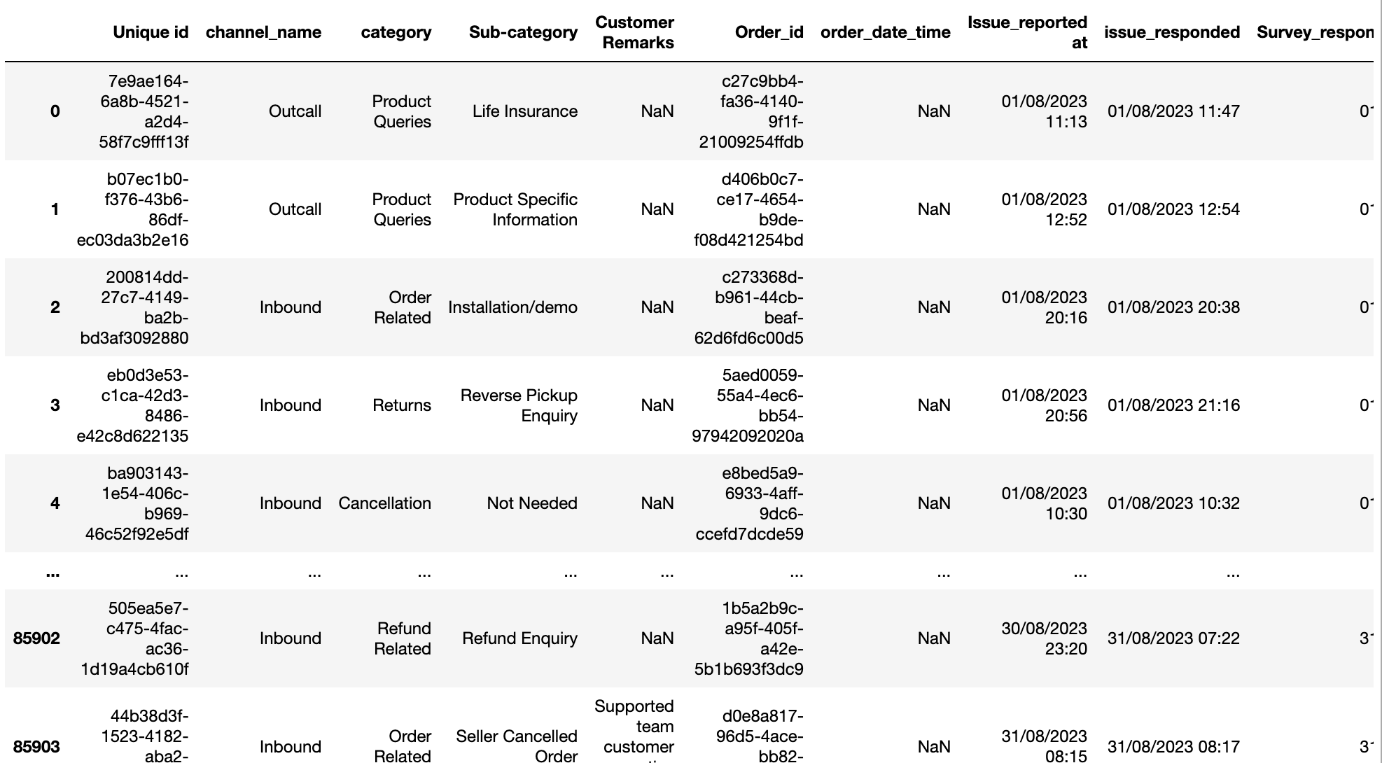
Result analysis
Datasets

Slide 19
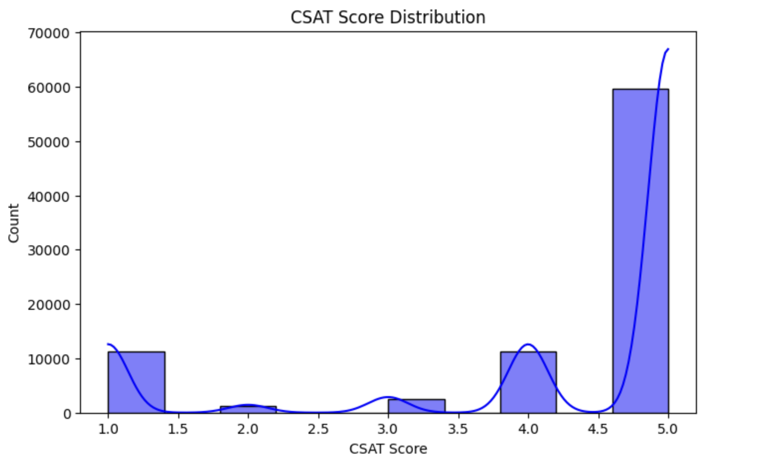
Model used
# Plotting histograms and KDE
fig, axes = plt.subplots(3, 2, figsize=(15, 20))
columns = ["Distance", "1A", "2A", "3A", "SL"]
for i, col in enumerate(columns):
sns.histplot(df[col], bins=30, kde=True, ax=axes[i//2, i%2])
axes[i//2, i%2].set_title(f"Distribution of {col}")
plt.tight_layout()
plt.show()

Slide 20
Advantages & applications
Applications:
Logistics and Delivery Services:
Companies like Blue Dart, and Ekart can apply the findings to improve delivery consistency and accurate
Advantages:
E-commerce Platforms: Amazon, Flipkart, and similar platforms can use it to how product are delivered, and customer communication
Real-Time Tracking Insight
Optimized Delivery Process
Enhanced Customer Loyalty
Reduced Return Rates

Slide 21
Conclusion
These projects are successfully demonstrate how data analytics can uncover critical factories affecting customer satisfaction
This project shows how data analysis helps find the main source behind customer satisfaction
The different chats and analysis methods were used to understand what makes customers happy or unhappy
The results help improve delivery service and support systems in online shopping

Slide 22
Future scope
Real time analytics feature systems can include live boards dashboards to track delivery issues and customer feedback instantly
Ai based prediction models can be added to predict customer satisfaction and detect problems before they happen
Integration with delivery apps the system can be connected directly to Courier apps for real Real time delivery status and automated updates

Slide 23
References
Gupta, R., Sharma, T., & Mehta, S. (2023). AI for e-commerce logistics optimization. Journal of Business Analytics Singh, A., & Das, P. (2022). Sentiment mining from e-commerce reviews. https://doi.org/10.1109/XXXXX.2022.1234567
Chen, L., Zhang, Y., & Wu, H. (2021). Real-time delivery risk assessment using AI. Elsevier Logistics Review, 45(3), 120–135.
Zulfiqar et al. (2024) – AI in E-commerce Logistics. Focuses on AI’s role in optimizing supply chains, including demand forecasting and route planning
Fisk, R.P.; Tracking the evolution of the services marketing literature. J. Retail. 1993, 69, 61–103.
Stank, T.P.; Effect of service supplier performance on satisfaction and loyalty of store managers in the fast food industry. J. Oper. Manag. 1999, 17, 429–447.
Ha, N.T. Factors affecting online shopping intentions of Vietnamese consumers: Research expanding the theory of planned behavior. Vnu J. Econ. Bus. 2016, 32, 21–28.
Rao, S.; . Electronic logistics service quality (e-LSQ): Its impact on the customer’s purchase satisfaction and retention. J. Bus. Logist. 2011, 32, 167–179.
Griffis, S.E.;. Linking order fulfillment performance to referrals in online retailing: An empirical analysis. J. Bus. Logist. 2012, 33, 279–294.
Chen, S.-C. The customer satisfaction–loyalty relation in an interactive e-service setting: The mediators. J. Retail. Consum. Serv. 2012, 19, 202–210.

Slide 24
11. Quirk, P.; Forder, J. Electronic Commerce and the Law; John Wiley & Sons: Hoboken, NJ, USA, 2003.
12. Hou, H. Beijing Jiaotong Univ. 2004, 3, 10-16.
13. Yazdanifard, R. (2011). How Unreliable Delivery system Affects E- marketing Effectiveness, 10-14.
14. Huang, Y., & Oppewal, H. (2006). Why consumers hesitate to shop online: An experimental choice analysis of grocery shopping and the role of delivery fees, International Journal of Retail & Distribution Management, 34(4/5), 334–353.
15. Huang, Y., (2006). Why consumers hesitate to shop online: An experimental choice analysis of grocery shoppingS and the role of delivery fees, International Journal of Retail & Distribution Management, 34(4/5), 334–353.
16. Sourabh Bhattacharya, B. B. (2015). Evolution, Growth and Challenges in E-commerce, SUMEDHA Journal of Management, 45-58
17. Averbakh, I. (2012). Semi-online two-level supply chain scheduling problems, Journal of Scheduling, 15(3), 381-390. 18. Restuputri, D.P.The effect of logistic service quality on customer satisfaction and loyalty using kansei engineering during the COVID-19 pandemic. Cogent Bus. Manag. 2021, 8, 1906492. 19. Bayles, D.L. E-logistics & e-fulfillment: Beyond the “buy” button. In Proceedings of the UNCTAD Workshop, Geneva, Switzerland, 6 June 2002. 20. Soh, K.L.. A theoretical model to investigate customer loyalty on logistics service providers for sustainable business performance. Int. J. Bus. Perform. Supply Chain Model. 2015, 7, 212–232.

Slide 25
Thank you

